Slide 1
Leveraging Data for Smart Ticket Pricing at Big Mountain Resort
Presented by Alan Nguyen

Slide 2
Objective
Big Mountain Resort’s strategy for ticket pricing has relied on charging a premium at $81.00 without taking into consideration market conditions. Additionally, another chairlift has been set up, which has increased operational expenses by $1,540,000 annually.
We believe that by using a data-driven model, we can identify opportunities for Big Mountain Resort to increase their revenue by:
Identifying a competitive ticket price in-line with market rates
Implementing changes to facilities to lower operational costs

Slide 3
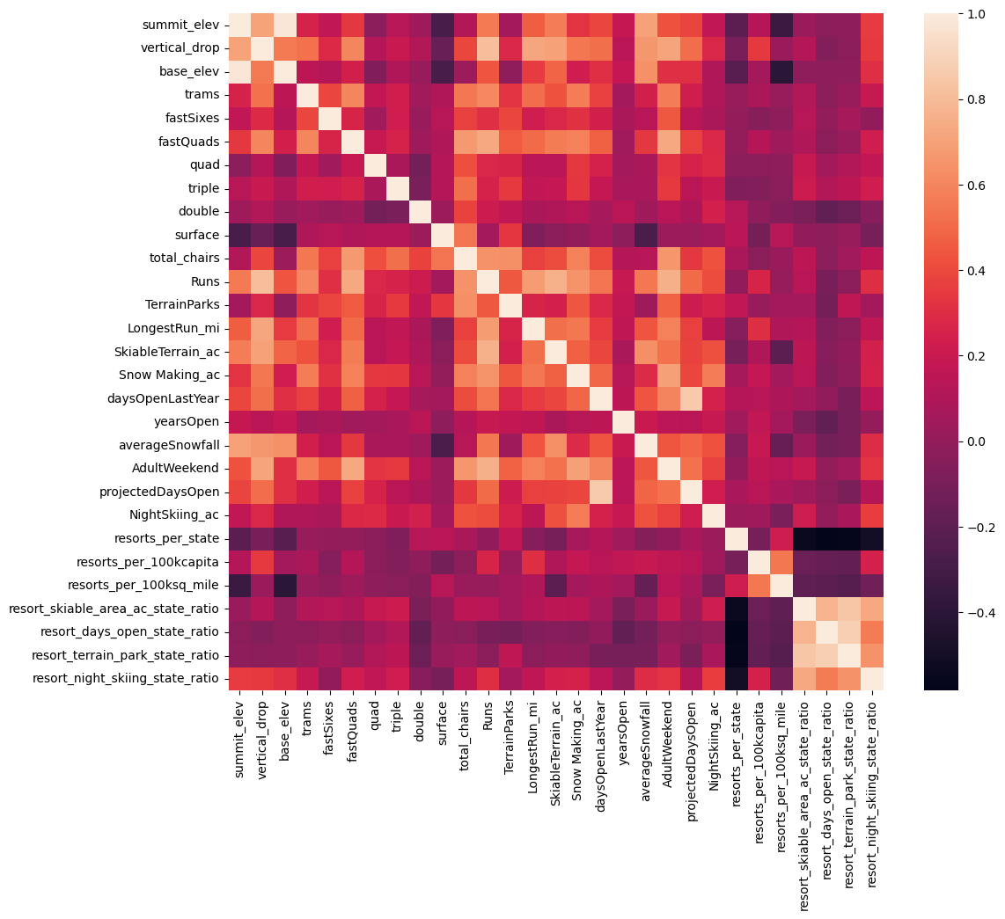
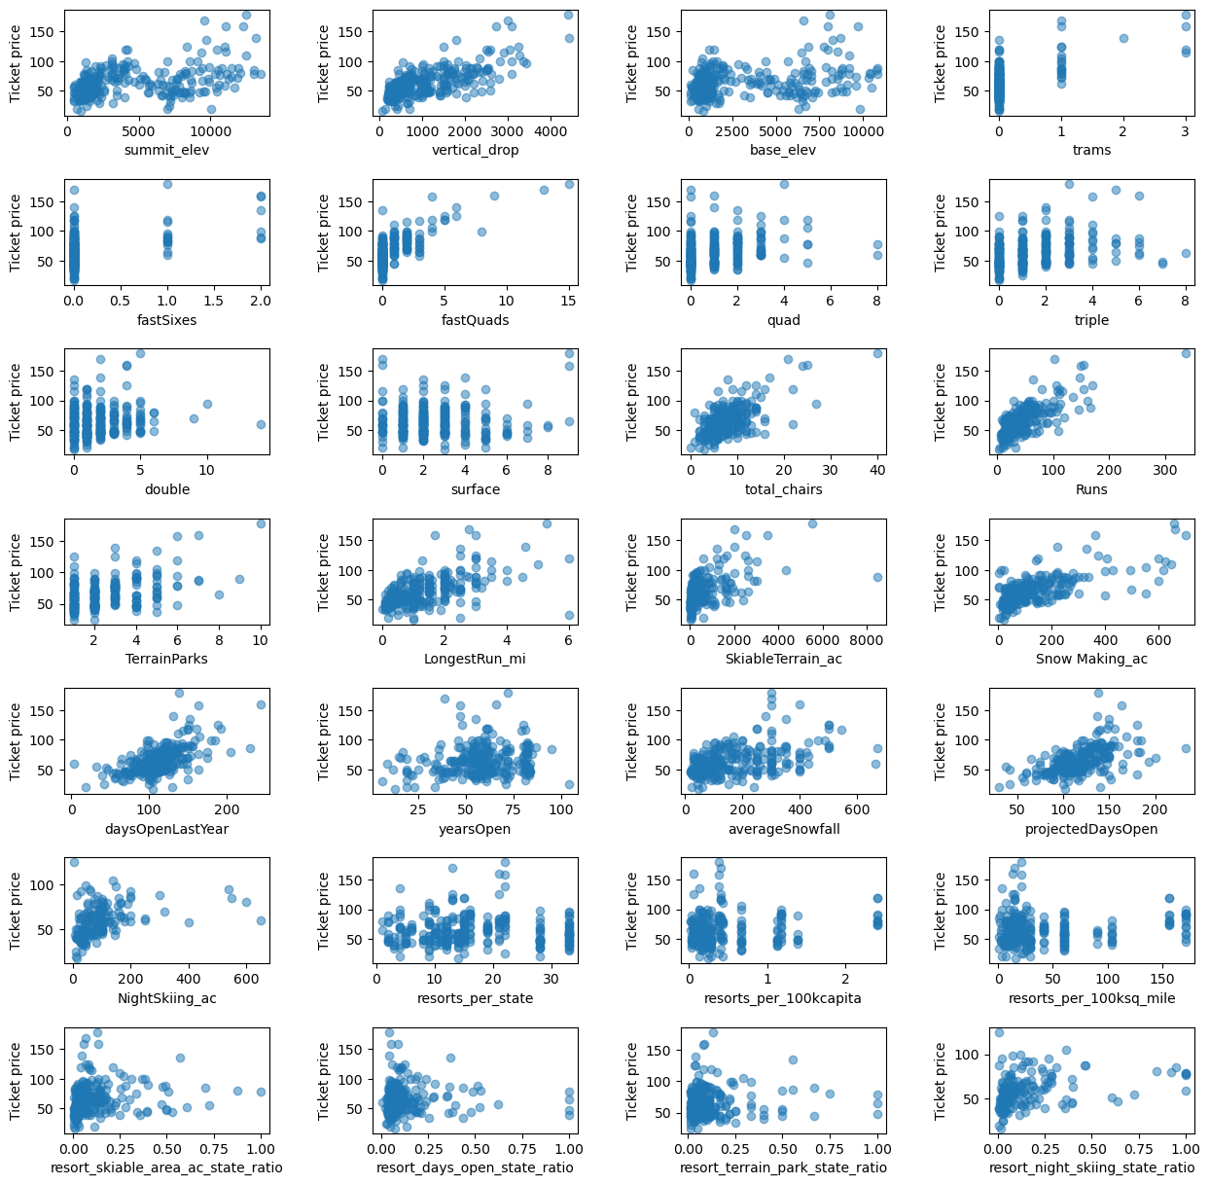
Metrics
The heatmap and scatterplots display the correlations between resort features and ticket price. Further analysis have determined that features such as vertical drop, snow making, the number of runs, and the number of chairlifts have an important effect on the pricing for tickets. We have modeled 4 possible business strategies that that show the effects from changes on the most desirable facilities.

Slide 4
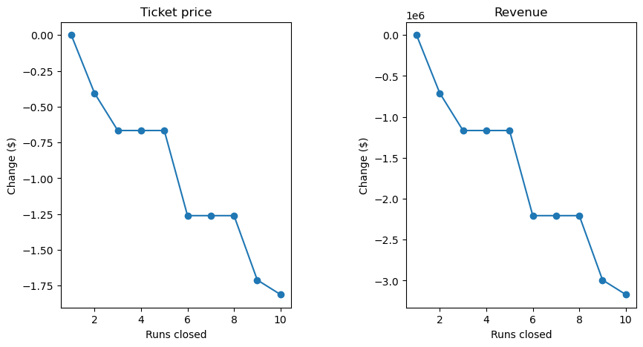
Scenario 1
Model: Closing up to 10 of the least used runs.
Result: Closing 1 run had no effect on ticket pricing/revenue, but closing any number from 2-10 runs resulted in increasing losses.
Suggestion: We do not advise on closing runs as a business strategy to minimize operation expenses.

Slide 5
Scenario 2
Model: Increasing vertical drop by 150 feet and installing an additional chairlift.
Result: This scenario supports increasing ticket prices by $1.99 resulting in an increased revenue of $3,474,638 over a skiing season.
Suggestion: We suggest that Big Mountain Resort explores this development plan that would align with the goal of increasing ticket prices while remaining competitive within the given market.

Slide 6
Scenario 3
Model: Increasing vertical drop by 150 feet, installing an additional chairlift, and increasing snowmaking coverage by 2 acres.
Result: The result of this scenario mirrors Scenario 2, but with an additional cost of running the snowmakers for additional coverage.
Suggestion: We do not suggest that Big Mountain Resort increases their snowmaking coverage in tandem with adding additional vertical drop or chairlifts as it will increase operational expenses without additional revenue gains.

Slide 7
Scenario 4
Model: Increase the distance of the longest run by an additional 0.2 miles while increasing snowmaking coverage by 4 acres.
Result: The model suggests that there will be no difference in revenue
Suggestion: We do not suggest that Big Mountain Resort pursues this development strategy as there will be increased operational expenses with no revenue gain.

Slide 8
Recommendation
Scenario 2 shows the greatest result within our prediction modeling that shows an increased revenue by approximately $3.5 million per ski season.
We suggest that Big Mountain Resort explores this business strategy as well as conducting additional analysis on other key features using this pricing model.

Slide 9
Summary
Our pricing model shows that increasing vertical drop and adding chairlifts will allow Big Mountain Resort to increase ticket prices. Further analysis through with the pricing model can be done in order to determine what other business strategies can be pursued to maximize revenue while maintaining or reducing operational costs.

